Slide 1
POWERPOINT ASSIGNMENT
YATHAVAKRISHNAN M
SF4659

Slide 2
Most Popular Components
DataGrid
Charts
List view
Scheduler
Diagram
PDF Viewer
Excel Library

Slide 3
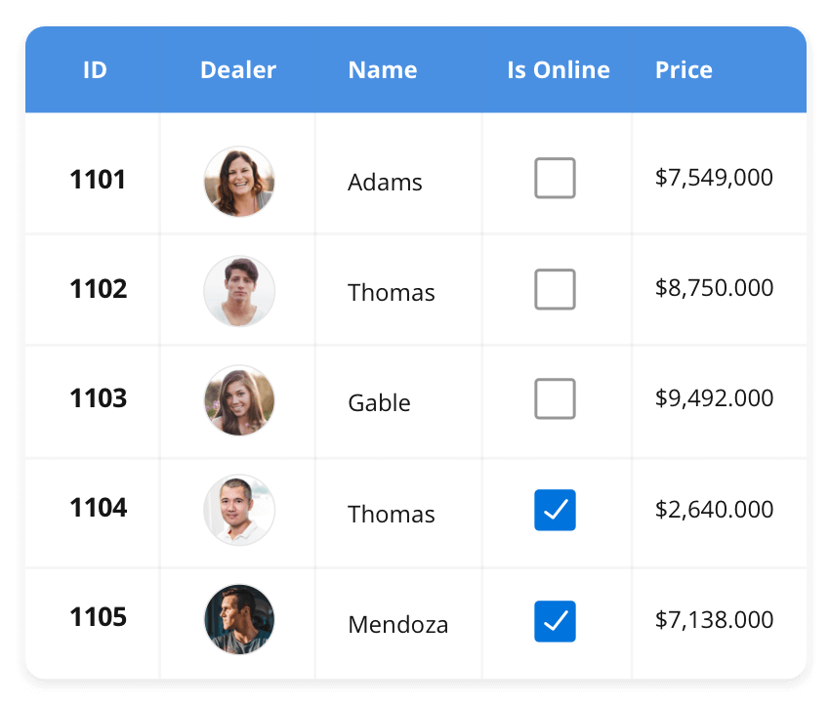



DataGrid The DataGrid control is a high-performance grid component that helps display and manipulate large amounts of data in a tabular format. Its rich feature set includes functionalities like data binding, sorting, grouping, editing, filtering, swiping, dragging, resizing, loading more items, pull-to-refresh, and exporting to Excel and PDF file formats.
SUPPORTED PLATFORMS
| JavaScript .react Vue Angular .Blazer .Flutter
. jQuery .ASP.NET core . ASP.NET MVC
| .WinForms . WPF .Win UI . Flutter .UWP
.NET MAUI
|. Xamarin . Flutter .UMP .JavaScript

Slide 4
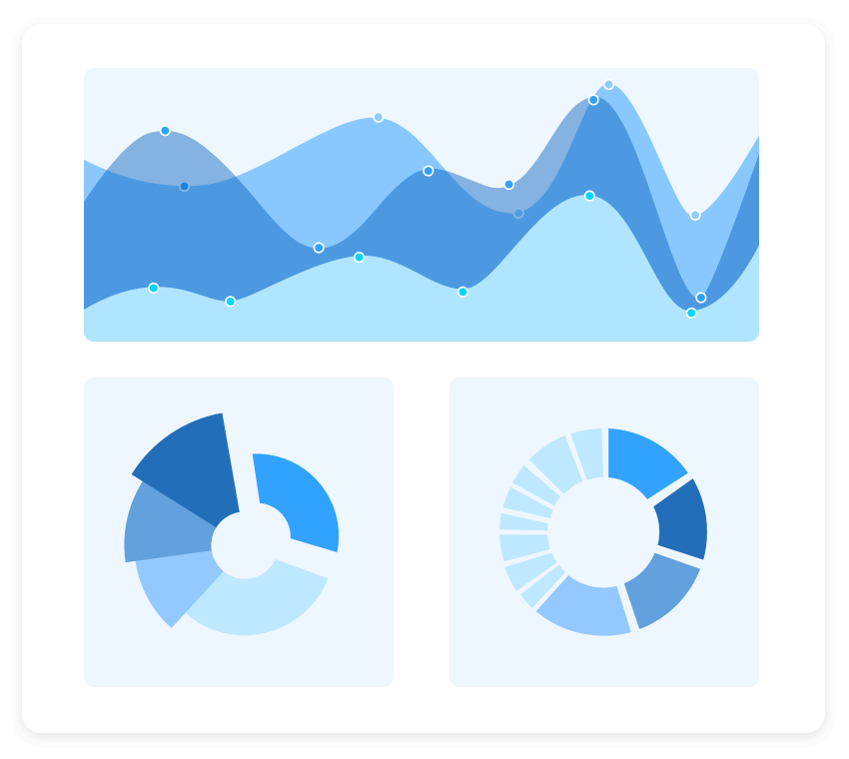
Charts The Charts control can plot a wide range of chart types, ranging from line charts to specialized financial charts. Its rich feature set includes functionalities like data binding, multiple axes, legends, animation, data labels, annotations, trackballs, tooltips, and zooming.
SUPPORTED PLATFORMS
| . JavaScript .react .Vue . Angular .Blazer .Flutter
. jQuery .ASP.NET core . ASP.NET MVC
| .WinForms . WPF .Win UI . Flutter .UWP
.NET MAUI
|. Xamarin . Flutter .UMP .JavaScript

Slide 5
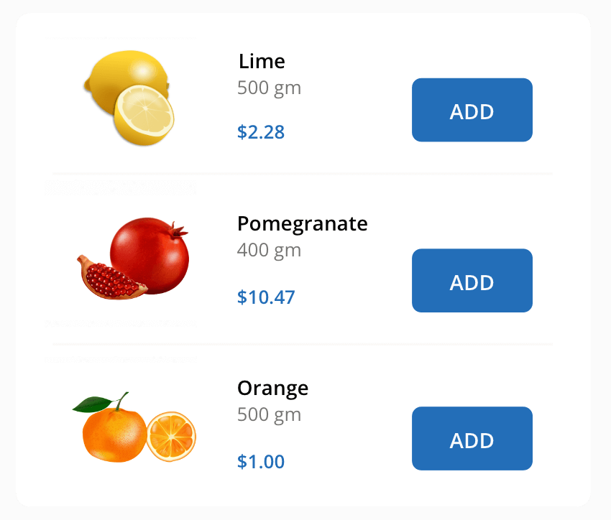
ListView The ListView renders a set of data items with UI views or custom templates. It has many features like grouping, sorting, filtering, paging, swiping, multiple selection, drag and drop, and different layout types. The ListView control has been optimized to work with large amounts of data.
SUPPORTED PLATFORMS
| . JavaScript .react .Vue . Angular .Blazer .Flutter
. jQuery .ASP.NET core . ASP.NET MVC
| .WinForms . WPF .Win UI . Flutter .UWP
.NET MAUI
|. Xamarin . Flutter .UMP .JavaScript

